Slide 1
RISCy Business
Thomas Haimes

Slide 2
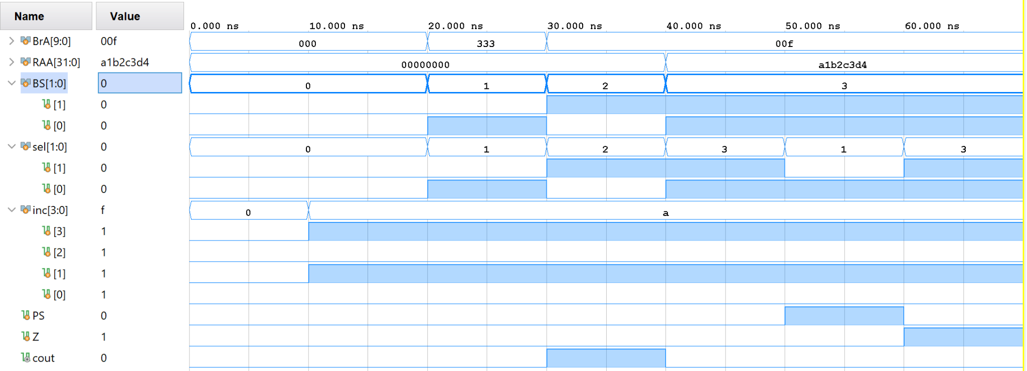
MUX C

Slide 3
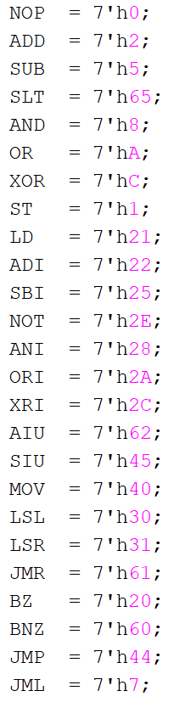
Instruction Memory
Not super sure about this one

Slide 4
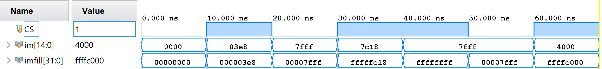
Constant Unit

Slide 5
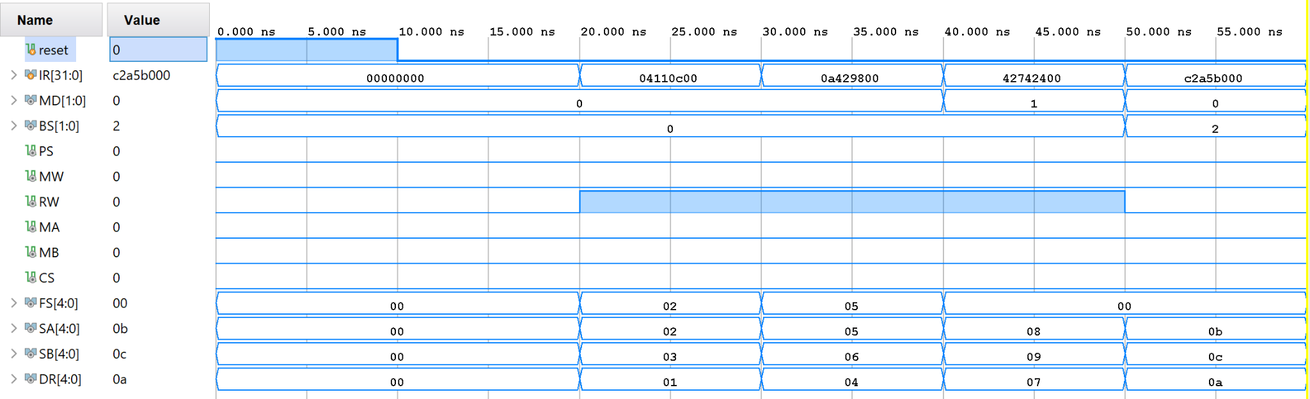
Instruction Decoder

Slide 6
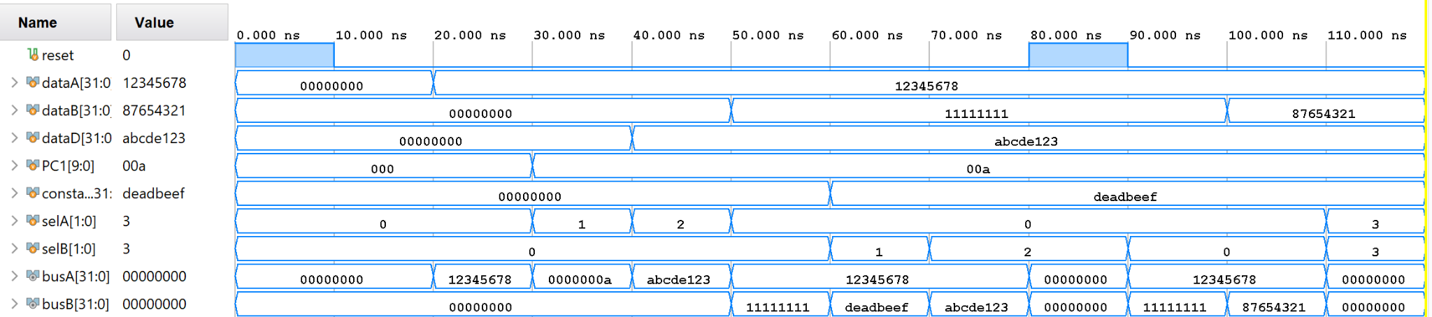
MUX A + MUX B

Slide 7
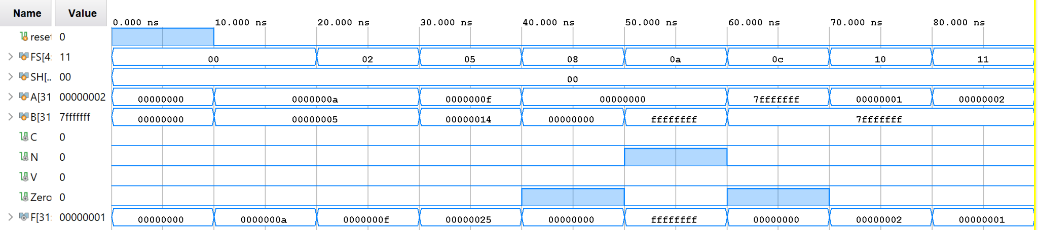
Modified Function Unit
Acquired from undergrad..
Missing some stuff but my brain got crispy :(

Slide 8
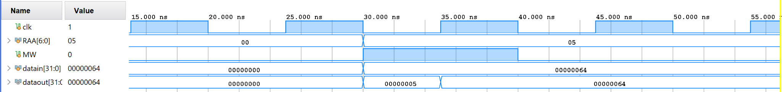
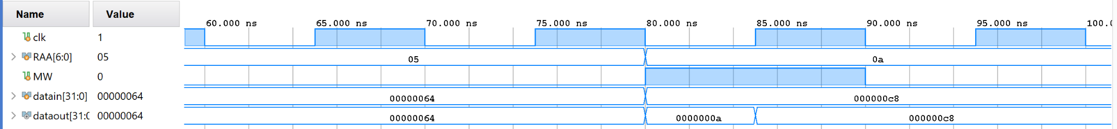
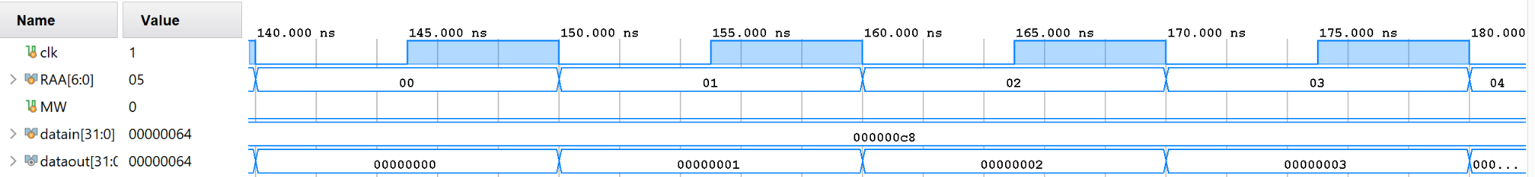
Memory Data
Skipped some sections where things didn’t change
More waves not included in this due to length

Slide 9
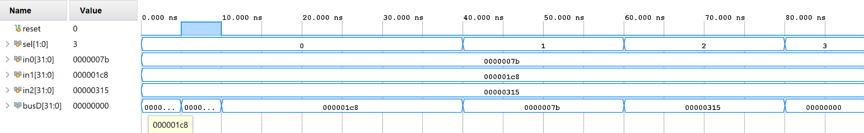
MUX D
Left 0000… is shown
Right 0000… is all zeroes

Slide 10
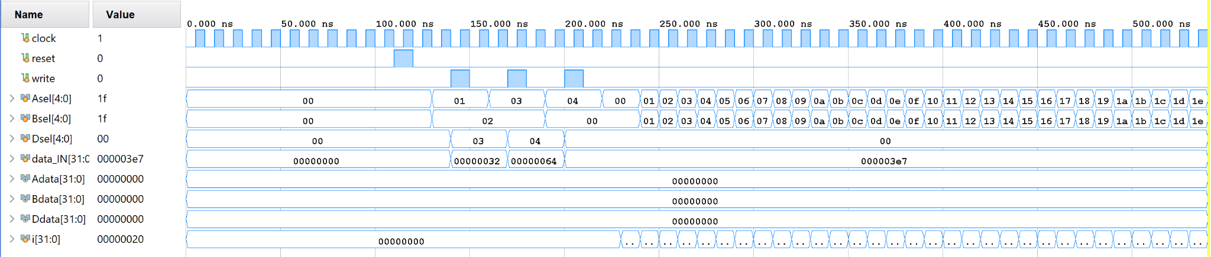
Register File
i is incremented each “...” is i + 1

Slide 11
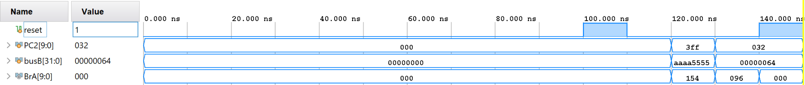
Adder
It adds!

Slide 12
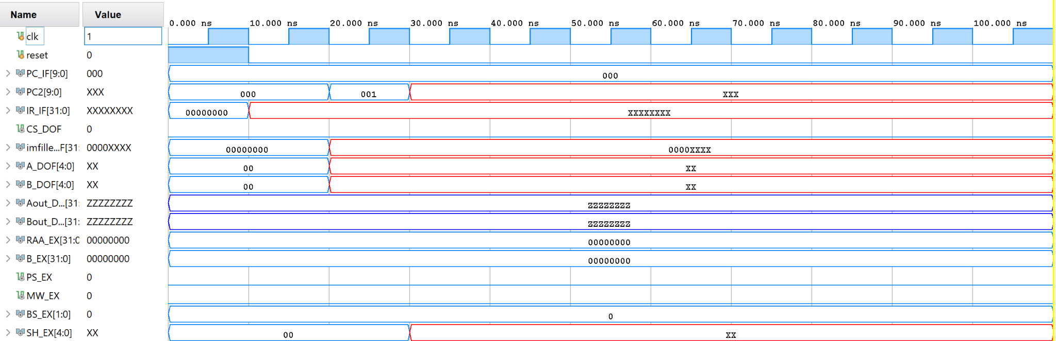
RISC Top
Issues in top module, will need to fix for following assignment :(

Slide 13
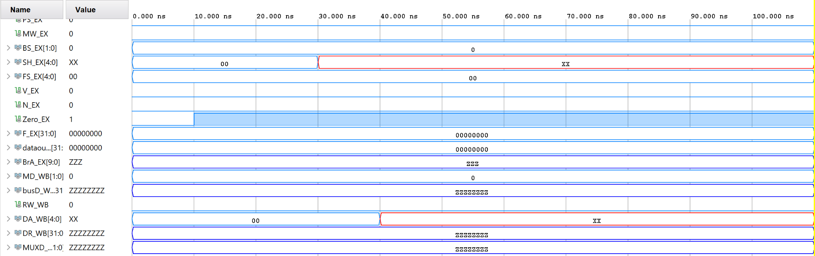
RISC Top Part 2

Slide 14
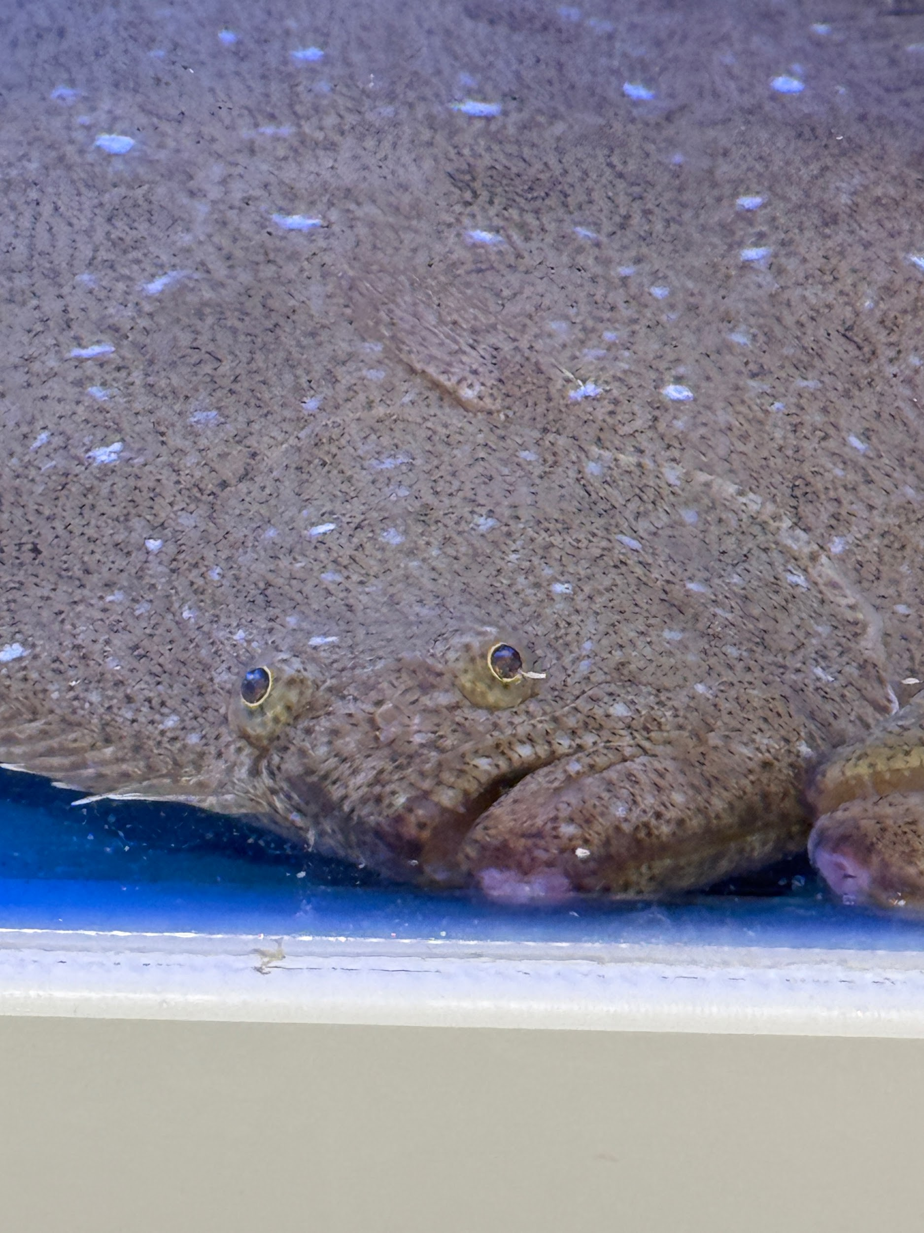
I present to you…
The face I made while working on this assignment…

